Slide 1
LOCAL SCHOLARSHIPS CLASS OF 2023
GCCISD LOCAL SCHOLARSHIPS PACKET & UPDATES
https://docs.google.com/presentation/d/1bTOWnZQFoz3_pTWWHrfcqaWSW8k2duoPedsgup_Mitw/edit?usp=sharing

Slide 2
You are getting closer to GRADUATION! As this exciting moment evolves, so do the nerves of college deadlines and the search for SCHOLARSHIPS!
Scholarships are free money to help you go to college, but the search can be overwhelming and exhausting.
To help you in your search, GCCISD has a scholarship program to advertise many of our local area scholarships and give you one area in which to apply.

Slide 3
GCCISD Local Scholarships
The local scholarships are provided to you by organizations, groups, and individuals in the local area who work very hard to raise money to offer these scholarships.
If these scholarship sponsors do not know you personally, they rely on the information that you provide. This information will be critical in helping them make the decision on who receives the money.
If you are to receive one of these scholarships, you should personally acknowledge the award and show your gratitude with a card or thank you letter.
This is great opportunity for you to earn some FREE MONEY for school!

Slide 4
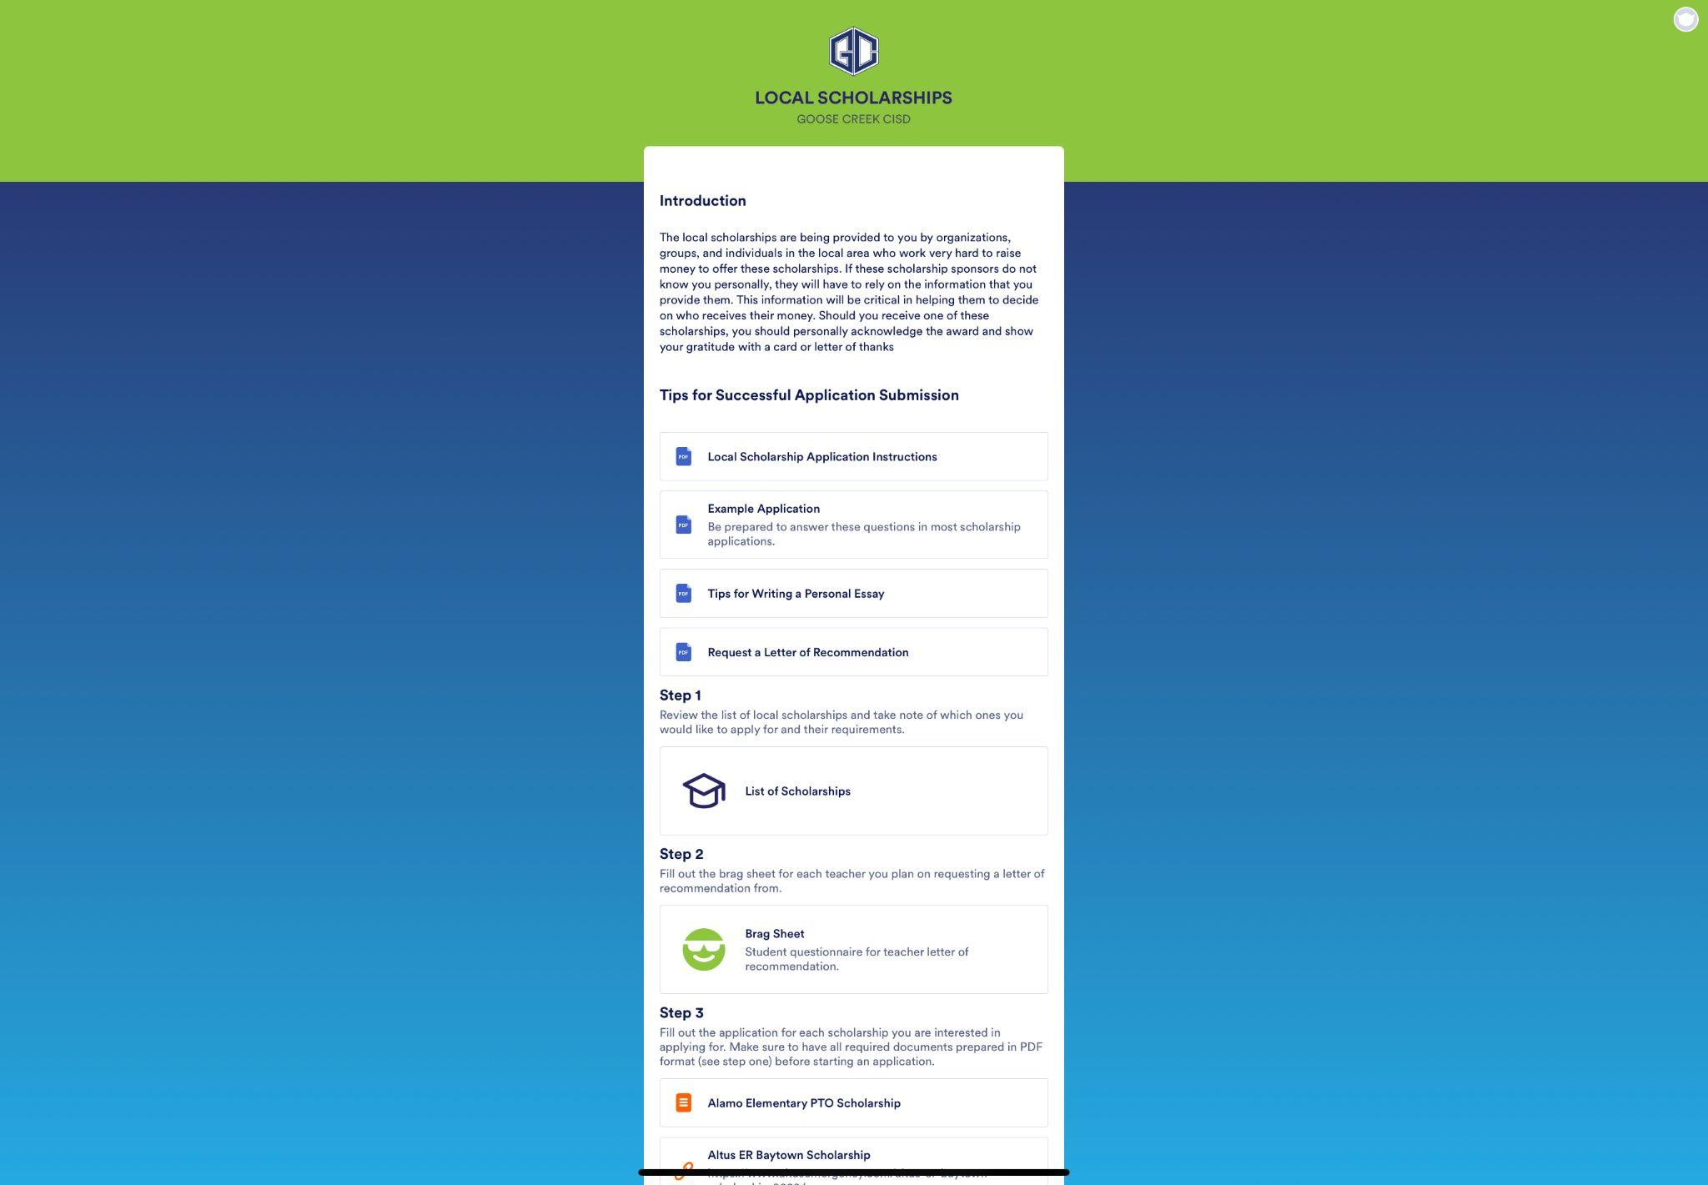
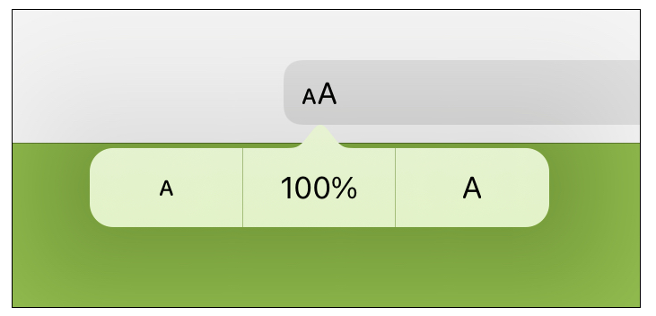
Application Process
iPad needs to be on school WiFi to get the app update for first time!
OR
https://gccisd.jotform.com/app/213346575032149
You will need to go to the address bar, click the As, and select 100% to increase the size of the font.
We’re also in the student portal!

Slide 5
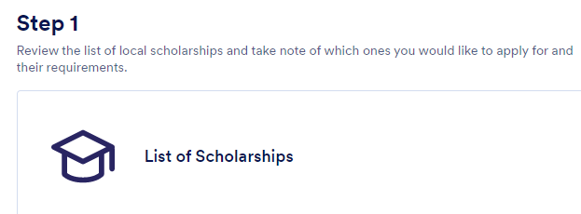
Application Process
TIP: Download the list once opened and then highlight it in Notability if you qualify for your records.
TIP: New scholarships may be added, so keep checking regularly!

Slide 6
Name of each scholarship is listed here.
These columns give you details on amount, eligible campuses, and requirements needed before you can apply.
This column is IMPORTANT! Read it to see if you meet the requirements. Some scholarships require that you went to certain elementary or junior highs, have relatives in their organization, have a minimum GPA or college major, or other requirements. Do NOT apply if you do not meet the requirements!

Slide 7
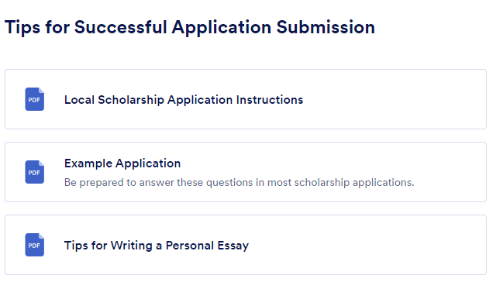
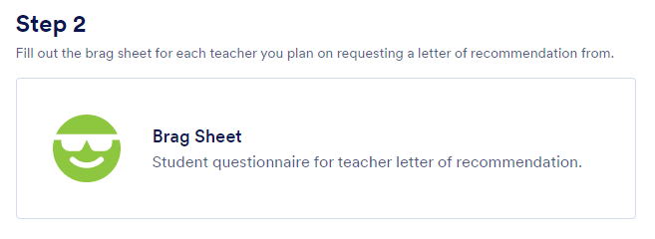
Get ready with these items:
Unofficial transcript
Notes app on your iPad can scan your transcript as a PDF
Personal statement/Essays
Letters of recommendation
Brag Sheet
Give them plenty of time. Request now!
School organizations/community involvement/honors & achievement lists
TIP: Complete this form for each letter you need. A copy will be emailed to you that you can then forward to your recommender.

Slide 8
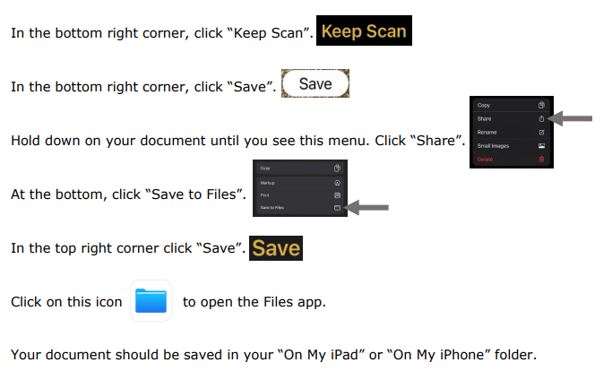
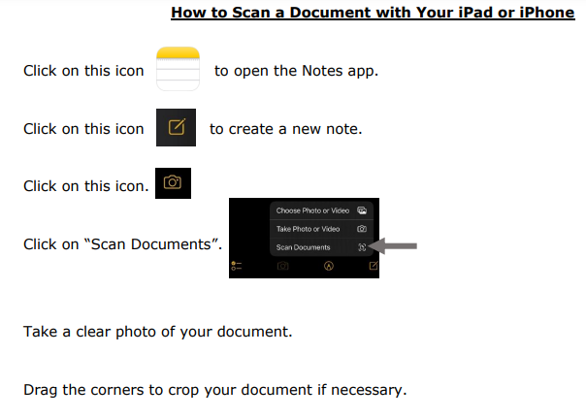
Transcripts
TIP: If you want to work outside of your iPad, you may want to save to Google Drive instead of in “Files.”

Slide 9
Important Tips
Be professional!!
Proofread your essays before submitting them.
Make sure you follow the guidelines for each scholarship.
Each scholarship has an individual application link that must be submitted.
All documentation must be ready for uploading prior to beginning the scholarship application process (ex: essays, letters of recommendation, transcript, etc).
Documentation must be saved as a PDF file!!

Slide 10
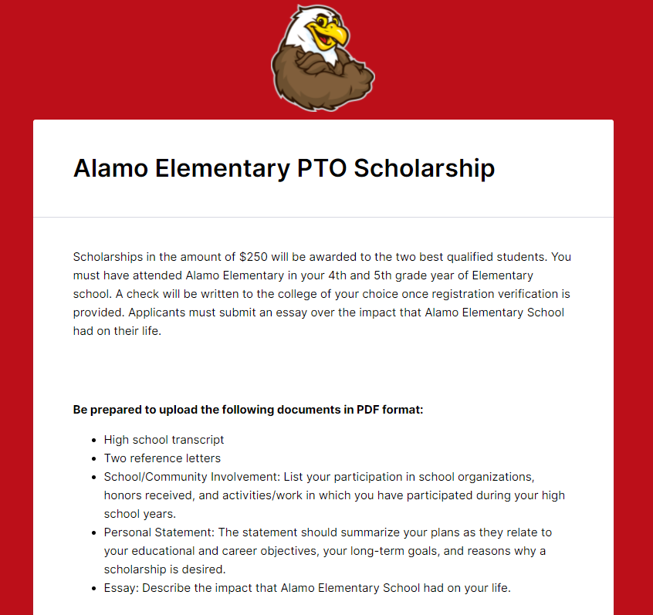
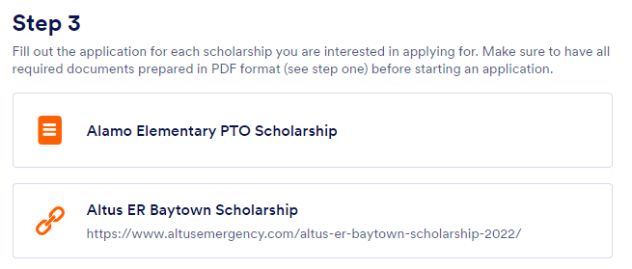
Filling out the Applications
Sample App
Click on each scholarship to see the requirements. You will need each piece of required information prior to completing the application, so work on the requirements prior to beginning filling in the blanks. TIP: Have transcripts, essays, letters of recommendation, etc. READY first!!
There is no save and finish later option.
Once you have all the required documents, most applications take less than 10 minutes on average to complete.
You must click submit before your application is processed.
You will receive an email with your application answers.
Internal Application
Requirements will appear here for each scholarship when clicked individually! Get these ready before applying!!
External Application
Link

Slide 11
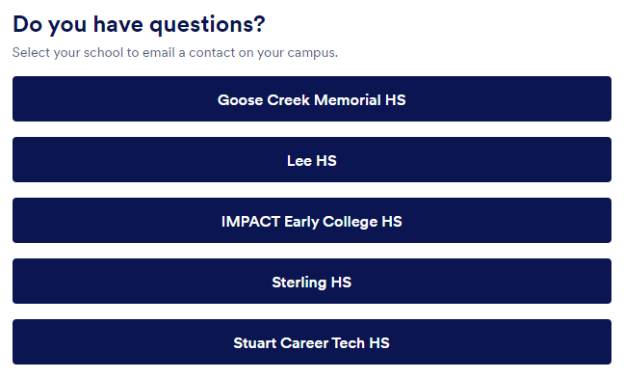
For questions, click on your high school at the bottom of the webpage to email a representative from your high school’s college & career center.

Slide 12
Deadline
Friday, March 3rd at 11:59 p.m.
Late applications will not be accepted under any circumstances!

Slide 13
Senior Spring to do list:
FAFSA/TASFA
Submit email to counselor
Jessica Marshall
Tuesdays or by appointment
Lee College Pop-Up Shop
Register for Fall Classes
Giant Decision Day Celebration
Slide show & Senior Picture Wall
Submit Scholarships & Awards for graduation program

